Slide 1
Mo
PHONES
Credit Portfolio Analysis
Data Analyst – Product & Credit | Case Study Submission
Portfolio Health
CX × Credit Outcomes
Data Quality
5 credit risk metrics
NPS vs arrears analysis
Gaps & recommendations
April 2026 | Confidential

Slide 2
Executive Summary
1 / 12
01 Portfolio Health
02 CX × Collections
03 Data Quality
NPE rising to 14.2% by Dec-24
3× NPS gap: Current (8.2) vs Default (3.0)
3 critical gaps limit monitoring accuracy
PAR30 reached 11.3% — above typical 10% watch threshold
18–25 cohort: NPE 1.8× portfolio avg (25.1% vs 14.2%)
Default rate stable at 3.9%, but early arrears accelerating
60% of defaulted customers are Detractors
Missed Call channel: avg NPS 3.1 vs WhatsApp 7.6
Collections friction is the primary driver of dissatisfaction
No payment-event table;cannot track cure rates
1.7% missing income data skews risk scoring
Zero employment duration causes silent calculation errors

Slide 3
Q1 — Portfolio Health: Selected Metrics
2 / 12
NPE Ratio
WHY IT MATTERS
1
Headline credit quality signal; drives provisioning requirements
% of active accounts 31+ DPD or in Default
PAR 30-60-90
WHY IT MATTERS
2
Balance-weighted; captures concentration risk in large accounts
% of outstanding balance held by accounts 30+ DPD
Default Rate
WHY IT MATTERS
3
Terminal loss indicator; triggers write-off and recovery processes
% of active accounts classified as Default
Impaired Rate
WHY IT MATTERS
4
Shows the proportion of risky or non-performing loans.
%of the total loan portfolio (or total active loans)
Avg Arrears / Impaired
WHY IT MATTERS
5
Drives collections workload; input for agent capacity planning
Mean arrears balance across accounts with any DPD

Slide 4
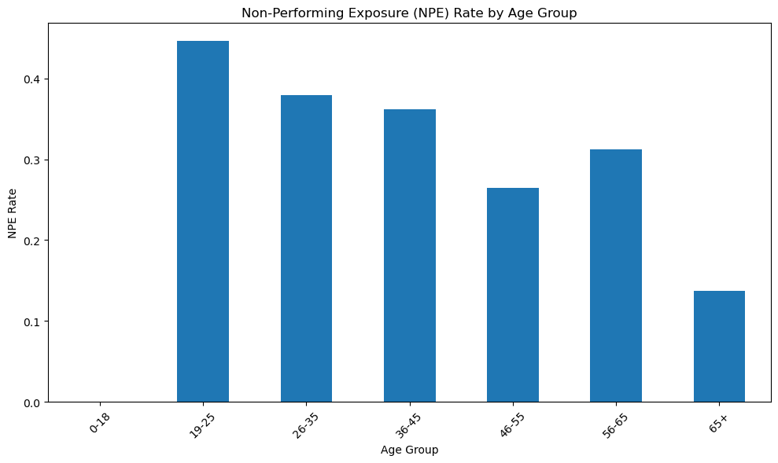
Q1 — Segment Risk: 19–25 Cohort is the Key Risk Driver
3 / 12
KEY FINDINGS
19–25 NPE rate is ~5.5% the portfolio average the single highest-risk age segment
26–35 cohort is slightly below average, likely due to informal employment income variability
46–55 customers show low risk, consistent with income stability at peak earning years
📌
Operationally: apply age-band multiplier in scorecard; tighten approval LTV for <26 applicants
Operational Implication
The 19–25 cohort likely has shorter credit histories, making default prediction harder with standard scorecards. Provisioning models that ignore age-band risk will understate expected credit loss. Recommend: (1) route <26 applications to enhanced underwriting, (2) increase deposit/downpayment for this segment.

Slide 5
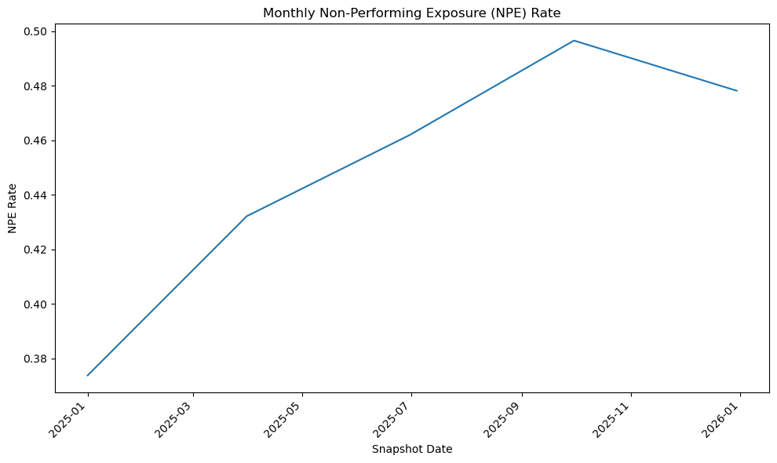
Q1 — Portfolio Trend: Jan–Dec 2025
4 / 12
NPE Rate
Default Rate
PAR30 Watch
45.69%
49.51%
53.96%
Jan to Dec 2025
SXYZGHGJG
Approaching 10% threshold

Slide 6
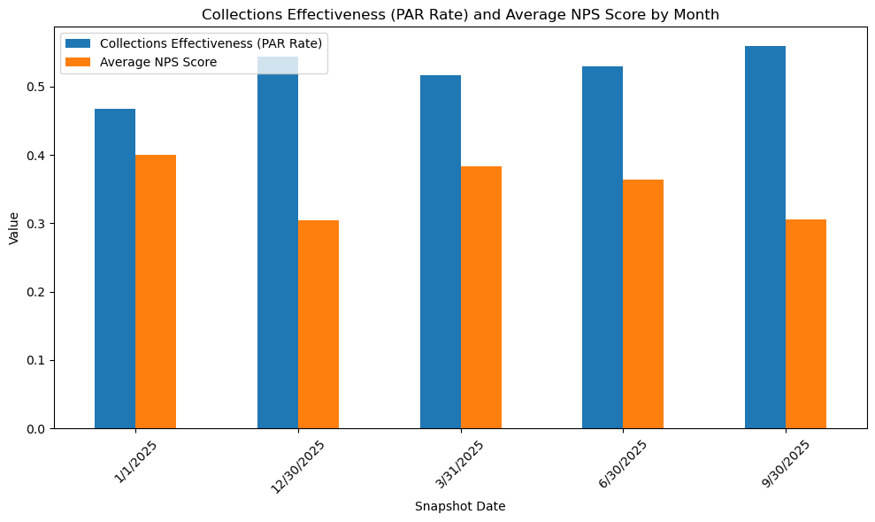
Q2 — NPS × Credit Performance
5 / 12
Correlation between Arrears Status and NPS Score:
NPS Score
Correlation
0.04
33.06
Relationship
Avg NPS Score
Correlation between NPS and Default Rate:
-0.91

Slide 7
Q2 — Collections vs CX: Insights
6 / 12
Insighs
Theme frequency in open-text feedback
Device / quality issues 192 mentions · avg 5.9
Payment terms / cost 81 mentions · avg 6.7
Phone locking / unlocking 75 mentions · avg 6.4
Customer support failures 66 mentions · avg 6.7
Grace period requests 30 mentions · avg 6.4
Payment not reflecting 14 mentions · avg 7.
563 ~Locked despite payment
722 ~Payment delay experienced
192 ~Device Quality

Slide 8
Q2 — Collections vs CX: Where the Tension Lives
7 / 12
THE TENSION
False locks. The most emotionally charged complaints involve phones locking on the same day a grace period was granted, or locking even though payment was made before the due date. Customers feel deceived — they did the right thing and still got punished. Several NPS 0–2 respondents describe sending formal emails and getting no reply.
Slow unlocking after valid payment. Even justified locks become a CX problem when the unlock takes hours. Customers expect near-instant unlocking; anything longer requires them to contact support, which is often unavailable.
Support unreachable during a lock event. The moments when customers most need support — when locked and uncertain why — are precisely when support is hardest to reach (after hours, weekends). Several customers note the phones line goes unanswered and WhatsApp responses take a day.
Charging during lockout. A subset of customers feel the loan accumulates while the device is unusable, which they consider deeply unfair. One respondent put it clearly: "why is it that I pay for a locked phone?"
THE PAIN POINT:
MoPhones relies on device locking to enforce repayments, which is standard in PAYG financing. However, the locking system works faster and more reliably than payment updates and customer support responses. This gap creates customer frustration, as users may get locked out even after paying or before issues are resolved.

Slide 9
Q2 — Collections vs CX: Recommendations
8 / 12
THE RECOMMENDATIONS
Introduce a pre-lock validation step to reduce false device locks:
Send an automated SMS/WhatsApp confirming payment status before any lock action
If a payment was made within the last 24 hours, temporarily stop the lock
Add a short delay (e.g., 2 hours) and recheck payment status before proceeding
This directly prevents cases where customers are locked out despite having already paid, addressing a major source of frustration.
Make the grace period system-enforced, not just a manual promise:
Add a flag (e.g., grace_period_active = true) that blocks all lock triggers
Include a grace_period_expiry field and require the lock system to check it before locking
Send an SMS confirming the grace period window to the customer
This ensures phones don’t lock during an agreed grace period, preventing trust breakdown and extremely low NPS scores.
Fix the mismatch between 24/7 collections and limited support:
Add weekend/after-hours coverage (e.g., a small Sat–Sun team) with authority to resolve lock disputes and issue same-day unlocks
Introduce a WhatsApp bot that lets customers submit payment proof, verifies M-Pesa transaction IDs, and auto-unlocks when valid
This ensures customers can resolve lock issues immediately, even outside normal business hours.
Enable self-service unlocking to eliminate support delays:
Show a USSD code (e.g., *384#) on the lock screen for customers to dial after payment
Build a USSD endpoint that verifies payment and automatically triggers an unlock
Update the lock screen with clear instructions for instant access
This removes the need for agent intervention and clears the unlock backlog.

Slide 10
Q3 — Data Quality: Issues Found
9 / 12
Customer_Age
Income and DOB files have 98.9% missing Loan Id
The column is named CUSTOMER_AGE but it contains loan age in days (confirmed by perfect correlation with SALE_DATE offset). Any analysis using this column as customer age including age-band segmentation will be completely wrong. Column should be renamed LOAN_AGE_DAYS
There's a major data integrity risk: most records are missing Loan IDs, which means demographic risk segmentation (income, age, gender) can only be performed on a very small subset of loans. This severely limits the reliability and representativeness of any risk analysis or credit decisioning based on this data.
No payment-event level data
Account_Status_L2 = 'Active' with Arrears > 0
Accounts marked as Active are carrying arrears, which understates true delinquency (PAR) exposure.
The credit snapshots show balances at a point in time but there is no table recording individual payment events (date, amount, method). Without this you cannot calculate cure rates, identify payment method preferences of good vs bad payers, or detect the payment reflection delays that the NPS data shows are a major CX problem.
Missing Income Fields
Income-band risk analysis is skewed. Excluded rows may be systematically different (e.g., informal workers), introducing bias.

Slide 11
Q3 — Data Improvements: 3 Recommendations
10 / 12
Build a mandatory Loan Id population check
01
WHAT: Enforce a mandatory Loan ID validation at the bureau API integration point—any incoming record without a resolvable Loan ID should either be rejected or assigned a traceable placeholder ID to ensure it can be linked later.
IMPACT:Restores usability of demographic datasets (income, DOB, gender) by enabling linkage to loans, unlocking full portfolio-level segmentation and materially improving the accuracy and completeness of risk analysis and decision-making.
Automate ACCOUNT_STATUS_L2 from DAYS_PAST_DUE.
02
WHAT: Replace the manual ACCOUNT_STATUS_L2 field with a system-derived status based on clear DAYS_PAST_DUE (DPD) rules (e.g., DPD = 0 → Active, DPD 1–7 → PAR 7, DPD 8–30 → PAR 30), with FPD/FMD handled using ACCOUNT_STATUS_L1 flags.
IMPACT: Eliminates inconsistencies where Active accounts carry arrears, ensures accurate and auditable PAR classification, and provides a reliable view of true delinquency exposure for better risk monitoring and decision-making..
Add a payment events table linked by LOAN_ID
03
WHAT: Implement a structured payments table capturing at minimum: payment_date, amount_kes, payment_method, reflected_date, and loan_id.
IMPACT:Enables measurement of payment processing delays (payment vs. reflection gap), making it possible to diagnose and resolve issues causing customer friction (e.g., phone locking), ultimately improving operational efficiency and NPS.

Slide 12
Proposed Data Model for Repeatable Reporting
11/12
dim_customer
fact_loan_perfomance
fact_nps
customer_id
loan_id (FK )
gender
citizenship
date_of_birth
age (derived)
loan_id (PK/FK)
date (FK → dim_date)
total_paid
total_due_today
balance
closing_balance
advance
balance_due_to_date
arrears
days_past_due
payment
expected_payment
payment_amount
adjustment_amount
prepayment_amount
deposit
weekly_rate
discount
overpayment_amount
total_paid_with_adjustments_15d
submission_id (PK)
loan_id (FK)
respondent_id
submitted_at (FK → dim_date)
nps_score
recommend_flag (derived later)
payment_delay_flag
support_difficulty_flag
battery_issue_flag
used_moapp_flag
phone_lock_issue_flag
dim_customer
dim_account_status
Loan_id (pk)
status_id (PK)
account_status_l1
account_status_l2
balance_due_status
fact_Sales
dim_product
sale_id (PK)
loan_id (FK)
sale_date (FK -dim_date)
return_date (FK → dim_date)
cash_price
loan_price
loan_term
returned (flag)
product_id (PK)
product_name
model
client_model
business_model

